Slide 1
QEP Steering Committee
Meeting
Monday, February 17, 1:30 p.m.
Agenda:
1. Definitions for our transferable skills
(the final four)
2. Framework for our QEP
(vote to decide today)
Next SASCOC Leadership Team Meeting:
Wednesday, February 26, 2:00 p.m.

Slide 2

Transferable Skills Categories
(Final list!)​
Communication
Technology
Professionalism
Decision Making

Slide 3

Proposal A: The Cascade Model
Curricular and co-curricular programs select 1-3 transferable skills to either:
  Address a gap in their existing curriculum/programming; or
  Improve a skill area(s) already present in their curriculum/programming
Identify one or more of the 3SLOs to focus on, using them to intentionally support the development and application of the chosen skill(s)
Identify the instructional/learning sites where the selected skill(s) will be taught
Plan targeted instruction and learning experiences to equip students with the selected skill(s)
Design/select artifacts to assess student progress toward the selected SLOs
A centralized advisory committee/board guides participating programs in designing meaningful and consistent assessment approaches by:
  Articulating general principles and flexible assessment approaches that align with the SLOs while respecting the unique context and goals of each program
  Reviewing program-specific assessment plans to ensure they reflect shared priorities for QEP impact report
  Facilitating cross-program collaboration and dialogue and targeted support to continuously improve assessment practices
Program participation in the Cascade Model is not mandatory.

Slide 4
Potential Benefits
As the name “Cascade” suggests, implementation flows simultaneously across programs, creating opportunities for institutional change on a broad scale (assuming there is buy-in)
The advisory committee/board provides a structured and consistent assessment framework to ensure data quality and comparability
Potential Challenges
All programs need to start with a gap analysis and make strategic decisions to enhance their curriculum/programming in those chosen skills. Given our time constraints, this may not be feasible.
Programs may argue that the transferable skills do not align with their priorities or view participation as an additional burden
Reviewing and guiding assessment plans may create a significant workload for the advisory committee if participation is widespread
Collecting, analyzing, and reporting on diverse artifacts from multiple programs may strain our resources and potentially create data overload
Optional participation may limit the model’s ability to drive broad institutional change (casting a large net may not help you catch many fish)

Slide 5
Proposal B: Gradual Scaling Model
Begin with a small group of curricular and co-curricular programs (e.g., 2-3 programs or one program from each college, and 1-2 co-curriculars, etc).
Participating programs identify 1-3 transferable skills to either:
  Address a gap in their existing curriculum/programming; or
  Improve a skill area(s) already present in their curriculum/programming
For participating curricular programs, implementation happens: at the course level (not section level), in required courses, or in courses targeting juniors and seniors
A centralized advisory committee/board serves as a guiding and accountability body to facilitate implementation of meaningful and consistent assessment approaches
Incentivize participation (e.g., course release, funding, professional development)
Expand the number of participating programs each year.
Use input from early adopters and refine the process for scalability.

Slide 6
Potential Benefits
Much more manageable rollout, compared to the cascade model, because it is on a smaller scale
Input from early adopters enables the QEP to evolve in ways that meet our needs
Compared to the cascade model, data collection for assessment purposes can be significantly more streamlined, as it will originate from a smaller, more controlled groups of implementation.
Potential Challenges
All programs need to start with a gap analysis and make strategic decisions to enhance their curriculum/programming in those chosen skills. Given our time constraints, this may not be feasible.
We may see slow/limited adoption, and starting small may delay the realization of institution-wide change
Programs not included in the early phases may feel overlooked and potentially disengage if the selection criteria is not transparent.
The success of early adopters may not fully translate to larger-scale implementation

Slide 7
Proposal C: Micro-credentialing Model
A select group of faculty and staff from curricular and co-curricular programs develop content for a micro-credential for each transferable skill area (e.g., 10-20 hours of content). Content = assigned learning and assessment activities. (No credit bearing)
Incentives (course release or stipends) are provided for creators of micro-credentials
Micro-credentials are housed within somewhere in the university’s structure and remain accessible to all students (e.g., Career Center, a new office?)
Students who complete a micro-credential receive a tangible form of recognition (e.g., badge)
A centralized advisory committee/board serves as a guiding and accountability body for the creators of micro-credentials.
Assessment takes place within the micro-credentials to provide a structured environment to measure and report impact on the QEP SLOs.

Slide 8
Potential Benefits
A neat space for QEP implementation: Embedding assessment activities within micro-credentials provides a structured and consistent platform for evaluating impact
Students earn recognizable credentials that enhance their employability and professional profiles
Micro-credentials can easily be tailored/updated to meet emerging institutional/student needs
The model has the potential to engage both curricular and co-curricular programs in collaboration during design and execution
Potential Challenges
Student engagement may be low (leading to few completions and limited data for assessment) if the micro-credentials as standalone offerings do not have a strong marketing and recruitment plan. Hence a strong communication campaign is essential
Developing high-quality micro-credentials requires time and effort, even with incentives, and creators of these micro-credentials may need professional development in this area

Slide 9
Proposal D: B and C Models (Both)
The Gradual Scaling (Proposal B) and Micro-credentialing (Proposal C) models operate as parallel tracks and provide two assessment channels.
A centralized advisory committee/board serves as a guiding and accountability body to facilitate implementation of meaningful and consistent assessment approaches in both tracks.

Slide 10
Potential Benefits
By offering both integrated and standalone options, this model increases accessibility and provides multiple pathways for students to engage with transferable skills
Potential Challenges
Having two separate assessment tracks could present challenges in tracking and collecting data effectively.
The advisory committee/board serving as a guiding and accountability body for the creators of micro-credentials and participating program may lead to an increased workload for the committee
Think of all the potential challenges that come with Proposal B and C; they all create a compounded effect

Slide 11
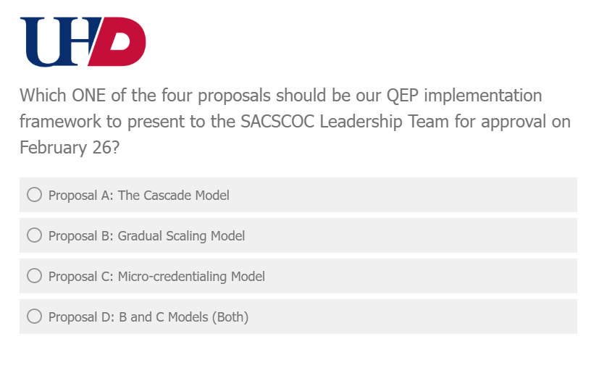

Please vote now on Qualtrics!
https://uhd.qualtrics.com/jfe/form/SV_3dPbLtvJwq5ANy6

